Slide 1

Department of
Communication Sciences and Disorders
“Applying to the M.S. and AuD Program at Cal State LA”

Slide 2

Things to consider
  How many schools will you be applying to?
  Are you applying to both Aud & SLP?
Will you be applying out of state?

Slide 3

Application Dates
Dates are extremely important to remember, and there are A LOT of dates. The most critical date you need to know is the deadline to apply! You absolutely cannot miss this date!!! You also need to know the dates to provide your professors with getting their letters in on time, and submitting your GRE and test scores.
MAKE A SPREADSHEET!!! Especially if you applying to multiple schools.
  Tuition
  Requirements of the schools
  Due dates
  Letters of recommendation
  Test scores
  Deadline for CSULA: January 15, 2021

Slide 4
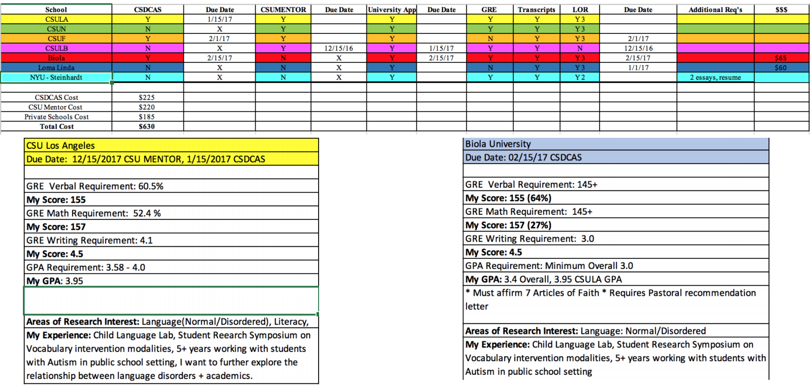
Example of a spreadsheet

Slide 5

Transcripts
Applicants are required to submit one (1) OFFICIAL transcript from ALL colleges and universities attended, in university sealed envelopes or through their e-transcript service, directly to the Office of Graduate Studies by the application deadline.
Applications will not be processed until all transcripts have been received.

Slide 6

Submission of Transcripts
Please do NOT send transcripts BEFORE you apply.
  If you are not yet in our system when they arrive, they may not be matched to your application, and your application will be delayed.
    CSDCAS is the only entity which will take transcripts early. University admission offices will require transcripts AFTER YOU APPLY.
Transcripts already on file with Cal State LA do NOT be resubmitted unless there is additional coursework to be reported.
  If you completed your Undergrad coursework at Cal State LA State, we do not need your transcripts again.
Allow for processing time for your transcripts!
  Call to confirm receipt of them!

Slide 7
Resume Tips
Ideally, start crafting and refining your resume the summer BEFORE so you can ask for letters in August/September.
Do not include soft skills
Do not include fancy fonts (K.I.S)
Add your achievements into your experiences & not into a seperate section
You want to hype yourself up but do not fake it.

Slide 8

Letter of Intent
This is often a document that entails what you plan to bring to the program.
  What skills you plan on obtaining at the end of the program.
Write thoughtful statements that stay true to yourself, but also demonstrate an understanding of the university and its mission.
This letter should be 500 words or less and serve as an additional resource for your readers when evaluating your application.

Slide 9

Personal Statement Tips
Ideally, you want to begin drafting it the summer BEFORE, but I know most of us did this throughout the Fall Semester and over winter break.
PROOFREAD!
Do not focus on what a school wants to here. Everyone has a different path to Audiology or Speech.
  A school is not looking for a study machine, they are looking for a valuable cohort member.
Take the time to tell your own story and show your voice and how that specifically drew you to Audiology or speech.

Slide 10
Letters of Recommendation Tips
This can be an intimidating process.
You want to make sure that the professor knows you well and long enough:
  Utilize office hours with faculty you hope to ask.
You want to ensure that the professor has a high opinion of you:
  Knows where you are applying
  Knows your grad school goals
Come prepared with your resume and any forms they require.
DO NOT ask you professor to write a letter for you a month before the application is due.
2 academic letter and 1 personal letter.

Slide 11

Getting ready for your Interview
Although the hard part is over, you may want to start thinking about the interview process.
Common questions for your interview
Why do you want to be an audiologist/ speech language pathologist?
Tell me about yourself
How do you believe you can make an impact on the field
Why this specific program at this specific university?

Slide 12
What are some things considered as "achievements"?
  Awards/Commendations
    Dean’s List, Scholarships, Elected to NSSLHA or another office, Golden Key or other Honor Society membership, Outstanding Student Awards, etc.
  Leadership positions
    NSSLHA, SAA, Employment, Volunteer Experiences
  Work Volunteer: SLPA, Audiologists Assistant
    10 week clinical experience including description of client(s)

Slide 13

FAQs
Do we need to wait to submit our transcripts until after this semester's grades come out, even if CSDCAS is saying that they want our transcripts ready four weeks before applications are due?
No. Submit twice, if desired.

Slide 14
On CSU website, the application asks for 3 faculty members to provide academic references. What if one of your recommenders is an SLP in the field and not a faculty member?
Applicants MUST submit three letters of recommendation, all of which must be submitted electronically through CSDCAS.
Two of these letters MUST come from Professors in Speech-Language Pathology, Audiology or Communication Disorders.
  The third letter may come from a Professor in Speech-Language Pathology or Communication Disorders, an ASHA certified speech-language pathologist, OR an employed professional in a related field. No exceptions.
If more than three letters are submitted, three letters will be selected by the faculty for review. If less than three letters are received, the applicant’s packet may be considered incomplete.

Slide 15
For CSU application, do we need to enter our work experience, academic references, and academic honors even though we are entering them on CSDCAS?
Yes!
Do we need to send our final transcripts to CSDCAS and the universities we are applying to?
Yes!
Do we have to use CSDCAS and Cal State Apply when applying to Cal State LA? Or can we use one or the other?
You must submit BOTH a CSDCAS and Cal State Apply application

Slide 16
I'm getting discouraged and wondering what are some less competitive Master’s programs to apply to in CA/US?
I am not in NSSLHA and some professors don't yet know my name, do I still have a chance of getting into the CSUS program?
All programs are competitive, but you DO still have a chance!
How many schools would you recommend applying to?
Up to the discretion of the applicant, but my opinion is at least three (3).

